Slide 1

Microservice Architecture with Spring Boot

Slide 2
Agenda
Introduction to Microservices
Monolithic vs. Microservices architecture
Benefits and Drawbacks
Ecosystem / Tools / Infrastructure
Load Balancer
Microservices usecases
Microservices with Boot
Designing Microservices
Creating a Eureka Service
Microservices communication
Configuration management
API Getway Service

Slide 3
Introduction to Microservices
Microservices is also known as the microservice architecture
An architectural style that structures an application as a collection of services.
Microservices = a collection of services
We break the entire application into smaller applications, each one can independently work
Such small applications can be developed, deployed and maintained independently.

Slide 4
Traditional Web Application Architecture
Consider an eCommerce application that takes orders from the customers, verifies the inventories and the customers’ credits and ships them
Example: Flipkart, Amazon etc.
In traditional method: We have many modules under one umbrella artifact (.war file)
Products module (Listing our products)
Customer details module (Maintaining customers)
Shopping module (add items to the cart)
Payment module

Slide 5
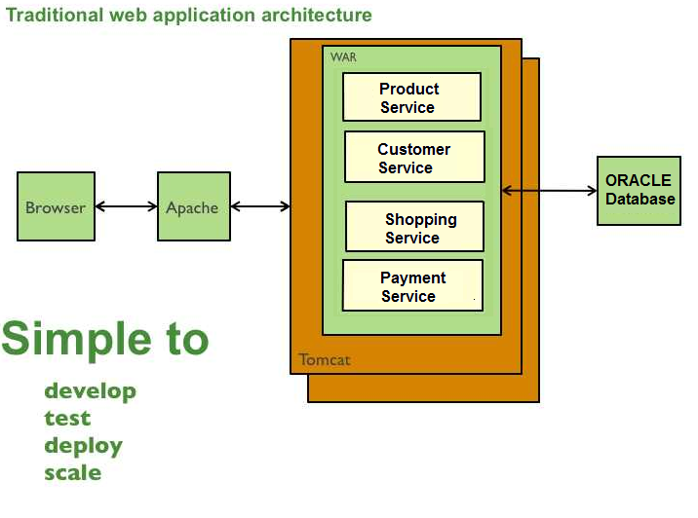
Traditional Web Application Architecture

Slide 6
Traditional Web Application Architecture - Issues
This simple approach has a limitation in size and complexity.
Application is too large and complex to fully understand and made changes fast and correctly.
The size of the application can slow down the start-up time.
You must redeploy the entire application on each update.
Continuous deployment is difficult.
Monolithic applications can also be difficult to scale when different modules have conflicting resource requirements.

Slide 7
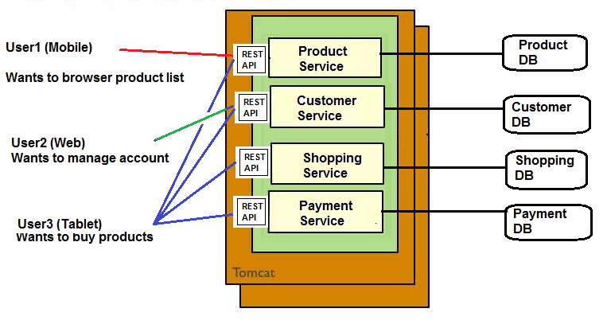
Microservices architecture
In Microservices architecture, the entire application is broken into smaller applications called services.
Enables SOC (Separation of Concerns)

Slide 8
Microservices - Benefits
Improved maintainability - each service is relatively small and so is easier to understand and change
Better testability - services are smaller and faster to test
Better deployability - services can be deployed independently
It enables you to organize the development effort around multiple, autonomous teams. Each team owns and is responsible for one or more services. Each team can develop, test, deploy and scale their services independently of all of the other teams.

Slide 9
Microservices - Drawbacks
Developers must deal with the additional complexity of creating a distributed system:
must implement the inter-service communication mechanism and deal with partial failure
Implementing requests that span multiple services is challenging
Testing the interactions between services is more difficult
Implementing requests that span multiple services requires careful coordination between the teams
Developer tools/IDEs are oriented on building monolithic applications and don’t provide explicit support for developing distributed applications.

Slide 10
When to use Microservices? - Usecases
Based on situation
During the first version of any application, this architecture is not needed (application is going to be relatively small & simple)
But, when the application evolves over period of time, developing distributed architecture will slow down the development viz.
Adding more features (you can’t pull the fat war files)
Need to scale individual modules/services
Autonomous team development is required
Devlopment, testing and deployment should not take more time

Slide 11
Ecosystem, tools and infrastructure
Infrastructure:
Platform As A Service (PAAS)
We can use Platform as a Service like Pivotal Cloud Foundry help to deployment, easily run, scale, monitor etc.
It supports for continuous deployment, rolling upgrades of new versions of code, running multiple versions of the same service at same time

Slide 12
Ecosystem: tools and infrastructure
Tools:
Use Spring Boot to create microservices
Setting up new service by using Spring Boot
Exposing resources via RestController
Consuming remote services using RestTemplate
Adding Spring Cloud and Discovery server
It provides microservices infrastructure like provide use services such as Service Discovery, a Configuration server and Monitoring.
It provides several other open source projects like Netflix OSS.
It provides PaaS like Cloud Foundry, AWS and Heroku.
It uses Spring Boot style starters

Slide 13
Ecosystem: tools and infrastructure
Infrastructure: Where should I host my microservices? (Amazon Web services, Azure, Oracle cloud etc.)
Orchestration: How should I manage the containers that host my microservices? (dockers, Kubernetes etc.)
API Gateways: How should I expose, secure and manage access to my microservices via APIs? Gate keeper between clients and microservices
Service Meshes: How should I manage the service-to-service communication between my microservices?
Serverless: Should I consider consuming cloud resources in a “pay-as-you-go” model or pre-purchase the capacity I need?
Security: How should I secure my containers and infrastructure?
Monitoring: How can I monitor the health and performance of my microservices and hosts?

Slide 14
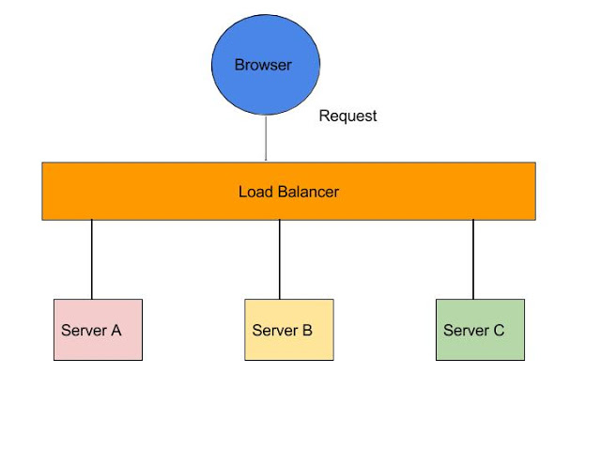
Server side Load Balancing such as Netscaler

Slide 15
Server side Load Balancing
In Java EE architecture, we deploy our war/ear files into multiple application servers,
then we create a pool of server and put a load balancer (Netscaler) in front of it, which has a public IP.
The client makes a request using that public IP, and Netscaler decides in which internal application server it forwards the request by round robin or sticky session algorithm.
We call it server side load balancing.

Slide 16
Server side Load Balancing - Problems
If one or more servers stop responding, we have to manually remove those servers from the load balancer by updating the IP table of the load balancer.
Another problem is that we have to implement a failover policy to provide the client with a seamless experience.
So, microservices DON’T USE SERVER SIDE LOAD BALANCING

Slide 17
Client Side Load Balancing
We will be using Eureka server for registering the microservices
It contains a list of registered microservices
If one microservice wants to communicate to another, it looks up the service registry using DiscoveryClient
Client side load balancing also maintains an algorithm like round robin or zone specific
Consul is another Microservices Discovery Server/tool

Slide 18
Client Side Load Balancing - Benefits
The service registry always updates itself
If one instance goes down, it removes it from its registry, so when the client side load balancer talks to the Eureka server, it always updates itself
So there is no manual intervention- unlike server side load balancing- to remove an instance.

Slide 19
What is Eureka?
Eureka is the Netflix Service Discovery Server and Client.
Eureka Server is using Spring Cloud.
When a client registers with Eureka, it provides meta-data about itself such as host and port, health indicator URL, home page etc.
Eureka receives heartbeat messages from each instance belonging to a service.
If the heartbeat fails over a configurable timetable, the instance is normally removed from the registry.

Slide 20
First microservice - HelloWorld
In this demo, we will see how to create a simple microservice that returns “HelloWorld”
We will register this microservice in Eureka server
We will start Eureka server
Then, we will create a program to discover this microservice and access it.

Slide 21
First microservice - HelloWorld
We need to create two maven projects:
First Maven Project: Microservice-DiscoveryServer (could be any name)
This will be playing the role of microservice registry
When you run this project, it will show all the microservices listing in this registry
This is a registry application

Slide 22
First microservice - HelloWorld
2nd Maven Project: HelloWorldMicroservice
We will be creating the Controller classes with methods to map to specific URI
We will be returning either view or Response body from these methods based on HTTP method types (GET, POST, DELETE, PUT etc.)

Slide 23
First microservice - HelloWorld
In the Discovery Service project (Microservice-DiscoveryServer), we will create application.yml or application.properties file to specify the port #
In the HelloWorld microservice project, we create application.yml or application.properties file to specify the port#, name under which this microservice to be registered and the Discovery service access (URL of the 1st project)

Slide 24
First microservice – HelloWorld – pom.xml
We need the following dependencies in our pom.xml file (Discovery Service Server)
First, we need spring-boot-starter-parent
<parent>
<groupId>org.springframework.boot</groupId>
<artifactId>spring-boot-starter-parent</artifactId>
<version>1.5.3.RELEASE</version>
<relativePath/>
</parent>

Slide 25
First microservice – HelloWorld – pom.xml
We need the following dependencies in our pom.xml file (for Discovery Service Server)
spring-cloud-starter
spring-cloud-starter-eureka-server (for registration server)
But, Spring Cloud Starter Eureka Server (deprecated, please use spring-cloud-starter-netflix-eureka-server)

Slide 26
What is spring cloud?
Microservice infrastructure
Spring Cloud provides tools for developers to quickly build some of the common patterns in distributed systems (e.g. configuration management, service discovery, circuit breakers, intelligent routing, micro-proxy, control bus, one-time tokens, global locks, leadership election, distributed sessions, cluster state).
So, we need this in our dependency list.

Slide 27
First Microservice – HelloWorld Configuration (application.yml)
Create a file “application.yml” under /src/main/resources folder (Mainly the host and the port #)
# Configure this Discovery Server
eureka:
instance:
hostname: localhost
client:
registerWithEureka: false
fetchRegistry: false
# HTTP (Tomcat) port
server:
port: 4567

Slide 28
What is yml file?
File contains configuration related settings
It is commonly used for configuration files and in applications where data is being stored or transmitted.
In Spring Boot, we can use YAML files instead of properties files.
YAML is a human-friendly data serialization standard but is mainly used for configuration files.
YAML files are more clear and human-readable in comparison to properties files and also provide several unique and useful feature for us.

Slide 29
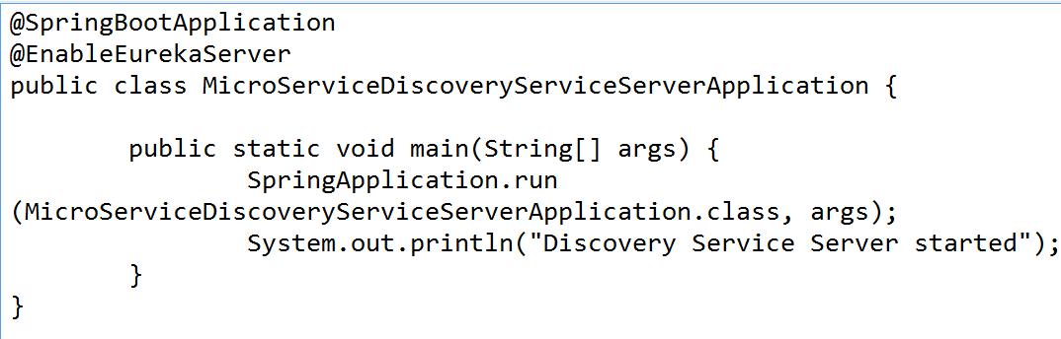
First Microservice – HelloWorld Main class
In order to run this registry server, we need to create a Java class as a Spring Boot Application and invoke run method:

Slide 30
First Microservice – HelloWorld Main class
Now, right click and run this main class as Spring Boot application
Then, open a browser and point to this URL:
http://localhost:4567/
You can see Eurkera server’s home page
At this point, no microservice has been registered, so you won’t see any microservice instance in Eureka’s home page

Slide 31
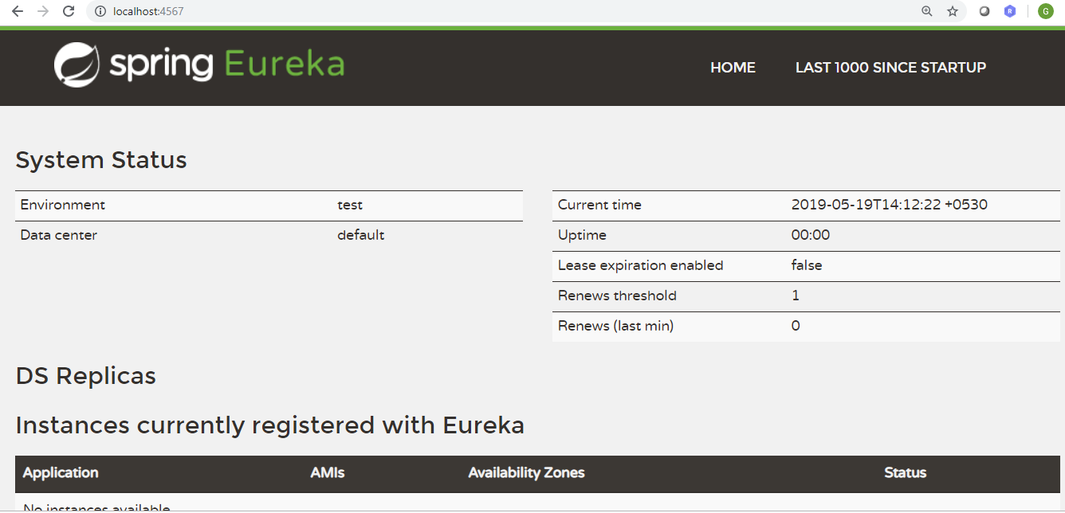
Viewing Eureka Home page

Slide 32
First Microservice – HelloWorld The producer
Now, let's create another Maven project for producing HelloWorld microservice and registers in Eureka server.
Create Apache Maven project: Project name: HelloWorldMicroservice
Add the same dependencies in pom.xml from the previous project

Slide 33
First Microservice – HelloWorld Create Controller class
@RestController
public class HelloWorldController {
@RequestMapping("/hello")
public String sayHello()
{
return "Hello World Microservice";
}
}

Slide 34
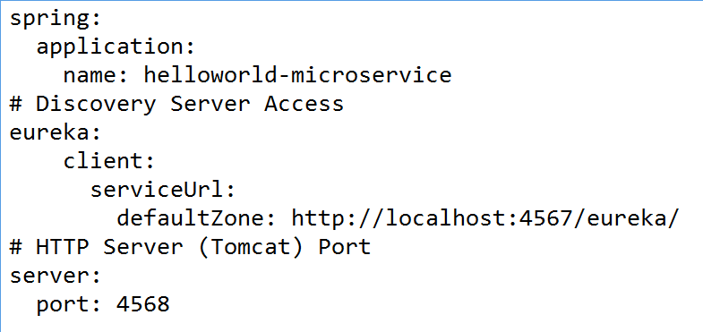
First Microservice – HelloWorld Configuration (application.yml)

Slide 35
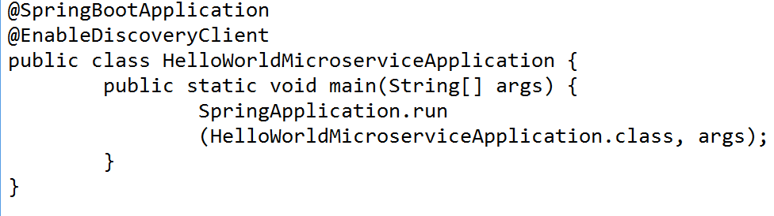
First Microservice – HelloWorld Main class (Application)
Run this as Spring Boot application
Open browser and point to http://localhost:4567/
You would see HelloWorld microservice is registered now ☺

Slide 36
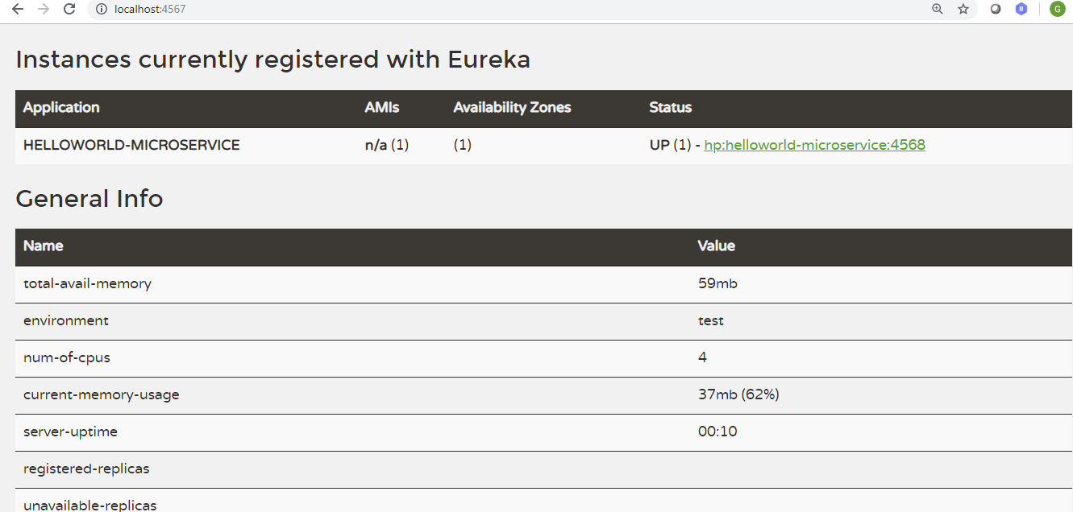
HelloWorld-microservice in Eureka listing

Slide 37
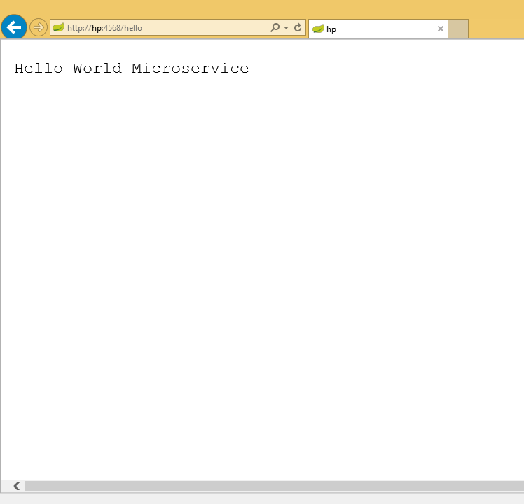
Accessing HelloWorld Microservice in browser

Slide 38
Various annotations we used
@EnableEurekaServer: Use in the Spring boot application class to enable the service registry
@SpringBootApplication: This mentions that the application is a Spring Boot Application
@EnableDiscoveryClient: Use this so that this microservice name can be discovered in the registry
Use this annotation mainly in the microservice class (not the service registry class)

Slide 39
Hands on
Create another microservice with the name “Welcome-microservice”
Define a controller class to map the following URI:
/info: Displays “This is welcome microservice” in <h1> tag
/welcome: Displays “Welcome” in <h1>tag
Register this in Eureka server
Verify that in browser, you see two microservices now and also access the above two URIs.

Slide 40
Case Study: Employee Management
Let’s create the following two microservices:
Employee microservice to add, delete, update and list the employee details
Project microservices to add, delete, update and list the Project details
Verify these two microservices working independently

Slide 41
Case Study: Employee Management Designing Employee class
Employee class has the following properties
int employeeId
String employeeName
Address add (user defined class)
List<Project>projects

Slide 42
Case Study: Employee Management Designing Address class
Address class has the following properties
int flatNo
String streetName
String city
Long pinCode

Slide 43

Microservices communication
Take this use case:
An employee has some projects
Employee details are found in Employee microservice
Project details are found in Project microservice
Now, we want to list out all projects of a particular employee

Slide 44
Ways of inter service communication
Using RestTemplate
Using FeignClient

Slide 45
Microservices communication RestTemplate
REST Template is the easiest way to establish synchronous communication in between services.
RestTemplate is a class available under spring.framework.web.client that acts as a synchronous client to perform HTTP requests and has ,

Slide 46
Microservices communication - RestTemplate
getForEntity(): executes a GET request and returns an object of ResponseEntity class that contains both the status code and the resource as an object.
getForObject() : similar to getForEntity(), but returns the resource directly.
exchange(): executes a specified HTTP method, such as GET, POST, PUT, etc, and returns a ResponseEntity containing both the HTTP status code and the resource as an object.
execute() : similar to the exchange() method, but takes additional parameters: RequestCallback and ResultSetExtractor.

Slide 47
Microservices communication – Feign Client
Feign makes writing web service clients easier with pluggable annotation support, which includes Feign annotations and JAX-RS annotations.
Also, Spring Cloud adds support for Spring MVC annotations and for using the same HttpMessageConverters as used in Spring Web.
One great thing about using Feign is that we don't have to write any code for calling the service, other than an interface definition.

Slide 48
What is if microservice fails?
If one microservice fails, then the others will still fail.
Now what’s the solution if we want highly available services
For testing purpose, you can shutdown Project microservice and try to access others, it will not work
Now we need more instance so that even one of them fails other still works.
Notes:
Talk about load balancing and how it works etc

Slide 49
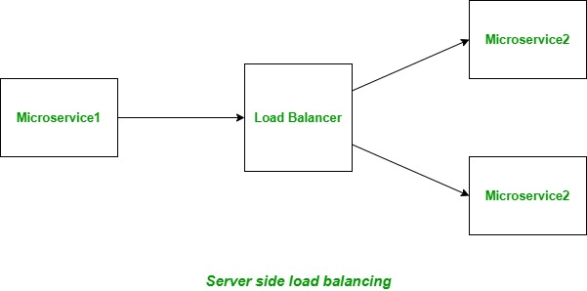
Server side load balancing
The instances of the service are deployed on multiple servers and then a load balancer is put in front of them.
It is generally a hardware load balancer.
All the incoming requests traffic comes to load balancer which acts as a middle component. Then it decides to which instance/service a particular request must be directed to based on some algorithm.

Slide 50
Disadvantages of server side load balancing
Server side load balancer is a single point of failure when it fails, all the instances of the microservice becomes inaccessible as only load balancer has the list of servers and it failed.
Each microservice will have a separate load balancer, so the overall complexity of the system increases and will hard to manage.
The network latency increases as the number of hops for the request increases from one to two with the load balancer

Slide 51
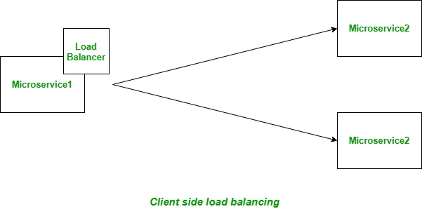
Client-side Load Balancing
The instances of the service are deployed on multiple servers. Load balancer's logic is part of the client itself and holds the list of servers.
It decides to which service a particular request must be directed to based on some algorithm.
These client side load balancers are also known as software load balancers.

Slide 52
Getway API
An API gateway is a service which sits in front of an API acts as the single-entry point for defined back-end APIs and microservices
As it sits in front of APIs, the gateway acts as protection, administering security and scalability, and high availability.
The API Gateway takes all API requests from a client, then determines which services are demanded, then combines the result and gave a unified for users.

Slide 53
Advantages of API Gateway
As we limit the access of external calls to all our services,it improves the security of the microservices.
The cross-cutting concerns like authentication, monitoring, metrics, and resiliency will be implemented only in the API Gateway as all our calls will be routed through it.
The client will not be able to determine the location of the microservice instances as the client does not know about the internal architecture of microservices system.

Slide 55
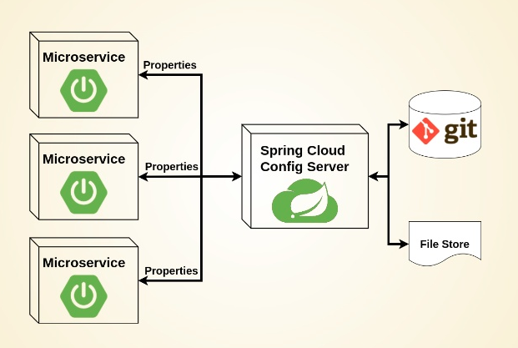
Configuration management

Slide 56
Spring Cloud Configuration Server is a centralized application that manages all the application related configuration properties.
Steps
Develop cloud config server
Create repository and files to it
Configure cloud config server to communicate with repo
Update service configuration to communicate with config server

Slide 57
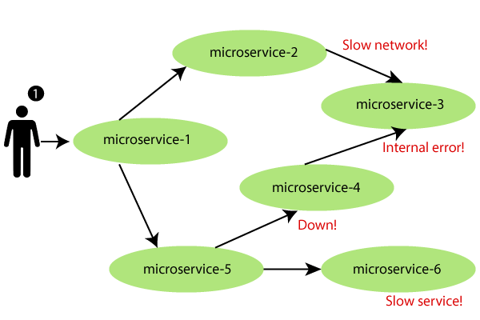
What is if microservice fails? Revisit
If one microservice fails, then the others will still fail.
All instances we had what if all failed?
One of the service is slow?
Notes:
Talk about load balancing and how it works etc

Slide 58
Fault tolerance
Fault tolerance can be achieved with the help of a circuit breaker.
It is a pattern that wraps requests to external services and detects when they fail.
If a failure is detected, the circuit breaker opens. All the subsequent requests immediately return an error instead of making requests to the unhealthy service.
It monitors and detects the service which is down and misbehaves with other services. It rejects calls until it becomes healthy again.

Slide 59
Circuit breaker
All services will fail or falter at some point in time.
Circuit breakers allow your system to handle these failures gracefully.
The circuit breaker concept is straightforward. It wraps a function with a monitor that tracks failures. The circuit breaker has 3 distinct states, Closed, Open, and Half-Open:

Slide 60
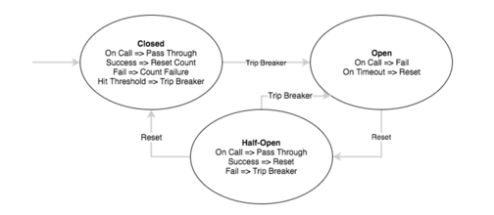

Slide 61
Closed – When everything is normal, the circuit breaker remains in the closed state and all calls pass through to the services. When the number of failures exceeds a predetermined threshold the breaker trips, and it goes into the Open state.
Open – The circuit breaker returns an error for calls without executing the function.
Half-Open – After a timeout period, the circuit switches to a half-open state to test if the underlying problem still exists. If a single call fails in this half-open state, the breaker is once again tripped. If it succeeds, the circuit breaker resets back to the normal closed state.

Slide 62
Demo Fault tolerance

Slide 63
Security

Slide 64
Need for security
The data is at most risk as malicious attacks moving their focus to applications/software and mobiles/devices from operating systems & networks.
From the business/client perspective, application security plays an important role in maintaining trust, building brand image & mitigating risks.
As per the most recent Verizon Data Breach Investigations Report-2020, 43% of all data breaches were attacks on web applications. This represented a doubling of the number from 2019. In addition, 86% of all breaches were financially motivated.

Slide 65
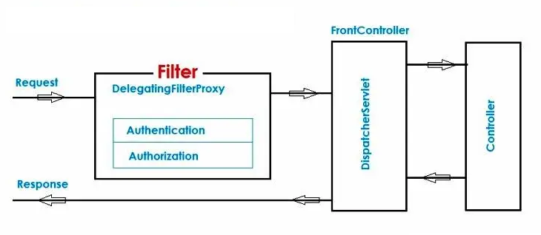

Slide 66
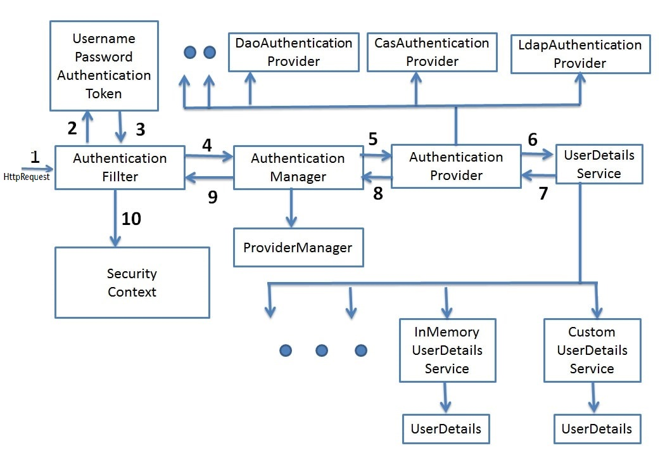
Spring security Architecture

Slide 67
Steps for implementing security
Write a class as ‘SecurityConfig.java’ that extends a predefined abstract class WebSecurityConfigurerAdapter.java
Apply annotations @Configuration and @EnableWebSecurity on top of ‘SecurityConfig.java’ accordingly. Needless to say, annotation @EnableWebSecurity is for enabling the security feature in web application.
Override below two methods to implement authentication & authorization logics simultaneously.
configure(AuthenticationManagerBuilder auth)
configure(HttpSecurity http)
Furthermore, Inject other objects dependency(if any), by using @Autowired like DataSource, BCryptPasswordEncoder etc. and use where you need them.
Equally important, Write controller classes and view pages consequently as needed.
In the end, update database properties in application.properties file if you are not implementing in-memory authentication.

Slide 68
OAuth2.0
OAuth 2.0 was developed by IETF OAuth Working Group and published in October of 2012.
It serves as an open authorization protocol for enabling a third party application to get limited access to an HTTP service on behalf of the resource owner.
It can do so while not revealing the identity or the long-term credentials of the user.
A third-party application itself can also use it on its behalf.
The working principle of OAuth consists of the delegation of user authentication to a service hosting the user account and authorizing the third-party application access to the account of the user.

Slide 69
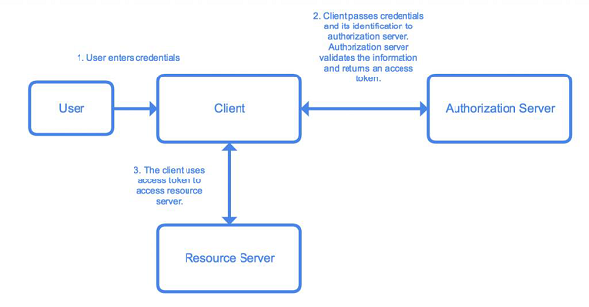

Slide 70
User / Resource Owner − The end-user, who is responsible for the authentication and for providing consent to share resources with the client.
User-Agent − The browser used by the User.
Client − The application requesting an access token.
Authorization Server − The server that is used to authenticate the user/client. It issues access tokens and tracks them throughout their lifetime.
Resource Server − The API that provides access to the requested resource. It validates the access tokens and provides authorization.

Slide 71
Monitoring services
Observability, which is comprised of monitoring, logging, tracing, and alerting aspects, is an important architectural concern when using microservices and event-driven architecture (EDA) styles, primarily because:
A large number of deployments require automation and centralization of monitoring/observability
The asynchronous and distributed nature of the architecture results in difficulties related to correlating metrics produced from multiple components

Slide 72
Monitoring is mainly comprised of the following four sets of activities:
Instrumentation of the application(s) — Instrumenting the application to emit the metrics that are of importance to the application monitoring and maintenance teams, as well as for the business users. There are many non-intrusive ways for emitting metrics, the most popular ones being “byte-code instrumentation,” “aspect-oriented programming,” and “JMX.”
Metrics collection — Collecting metrics from the applications and persisting them in a repository/data-store. The repository then provides a way to query and aggregate data for visualization. Some of the popular collectors are Prometheus, StatsD, and DataDaog. Most of the metrics collection tools are time-series repositories and provide advanced querying capability.

Slide 73
Metrics visualization — Visualization tools query the metrics repository to build views and dashboards for end-user consumption. They provide rich user interface to perform various kinds of operations on the metrics, such as aggregation, drill-down, and so on.
Alerts and Notifications — When metrics breach defined thresholds (for instance CPU is more than 80% for more than 10 minutes), human intervention might be required. For that, alerting and notifications are important. Most visualization tools provide alerting and notification ability.

Slide 74
Actuator
Spring Boot Actuator is a sub-project of the Spring Boot Framework.
It includes a number of additional features that help us to monitor and manage the Spring Boot application.
It contains the actuator endpoints such as HTTP and JMX endpoints to manage and monitor the Spring Boot application.
If we want to get production-ready features in an application, we should use the Spring Boot actuator.
It provides Endpoints, Metrics and Audit information

Slide 75
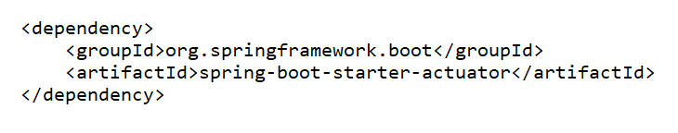
All endpoints are available at endpoint /actuator
By default /health and /info endpoints are enabled
management.endpoints.web.exposure.include=*
management.endpoints.jmx.exposure.include=health,info,env,beans

Slide 76
Micrometer
Micrometer provides a simple facade over the instrumentation clients for the most popular monitoring systems, allowing us to instrument our JVM-based application code without vendor lock-in.
Prometheus
Prometheus, a Cloud Native Computing Foundation project, is a systems and service monitoring system. It collects metrics from configured targets at given intervals, evaluates rule expressions, displays the results, and can trigger alerts when specified conditions are observed.

Slide 77
ELK Stack
The ELK Stack is a collection of three open-source products — Elasticsearch, Logstash, and Kibana. ELK stack provides centralized logging in order to identify problems with servers or applications. It allows you to search all the logs in a single place. It also helps to find issues in multiple servers by connecting logs during a specific time frame.
E stands for ElasticSearch: used for storing logs
L stands for LogStash : used for both shipping as well as processing and storing logs
K stands for Kibana: is a visualization tool (a web interface) which is hosted through Nginx or Apache

Slide 78
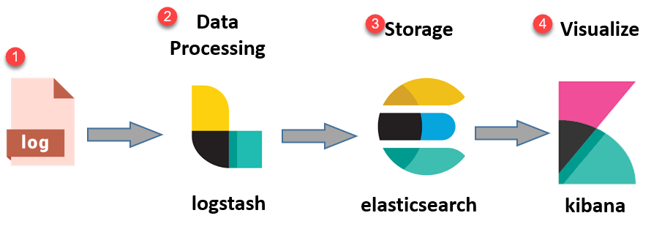
Logs: Server logs that need to be analyzed are identified
Logstash: Collect logs and events data. It even parses and transforms data
ElasticSearch: The transformed data from Logstash is Store, Search, and indexed.
Kibana: Kibana uses Elasticsearch DB to Explore, Visualize, and Share

Slide 79
End of Microservices Architecuture with Spring Boot

